Slide 1
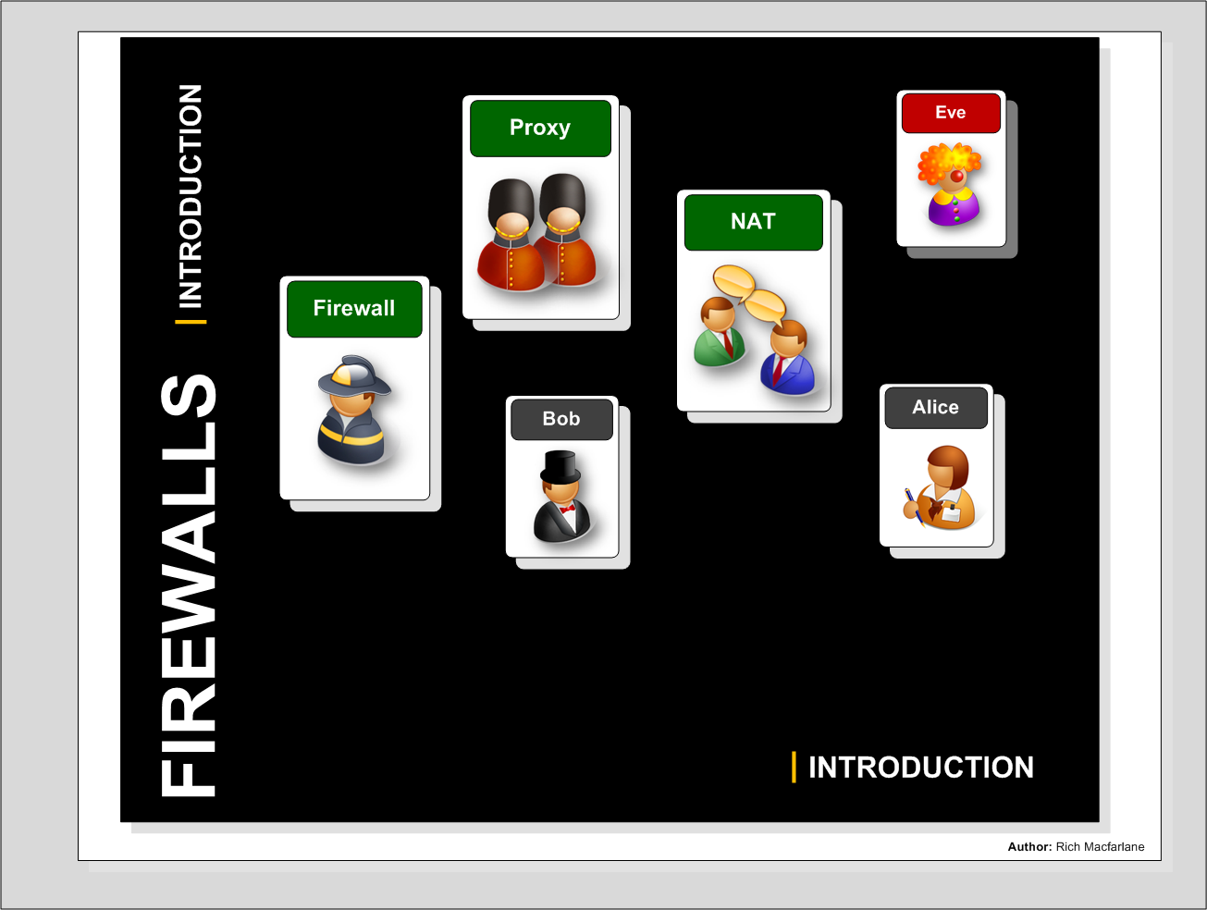
Perimeter Security
Firewall Fundamentals
Types of Firewall Implementation

Slide 2
Perimeter Security
Why Firewalls?
Mitigate Risks
Mitigate threats to assets from known vulnerabilities
Reduce services open to Internet
Mitigate trust attacks
Segregation/Privacy
Segregate organisational traffic from Internet
Hide organisations assets, systems/services from attackers
Harder to perform reconnaissance
Apply Organisation’s Security Policy
Create choke points that traffic has to pass through – perimeter and internal – apply filtering
Monitoring
Logging traffic passing through for analysing attacks
Fundamentals
Firewalls

Slide 3
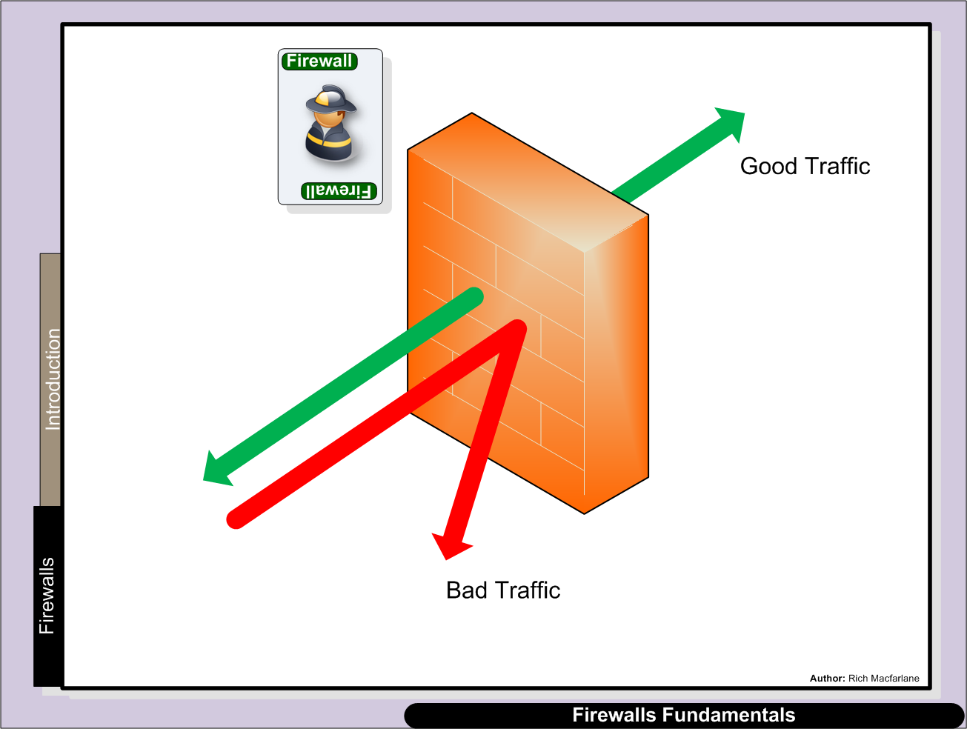
F/W term comes from buildings
Network Firewalls
Gateways between 2
networks
Allow Good traffic to pass
Reject Bad traffic

Slide 4
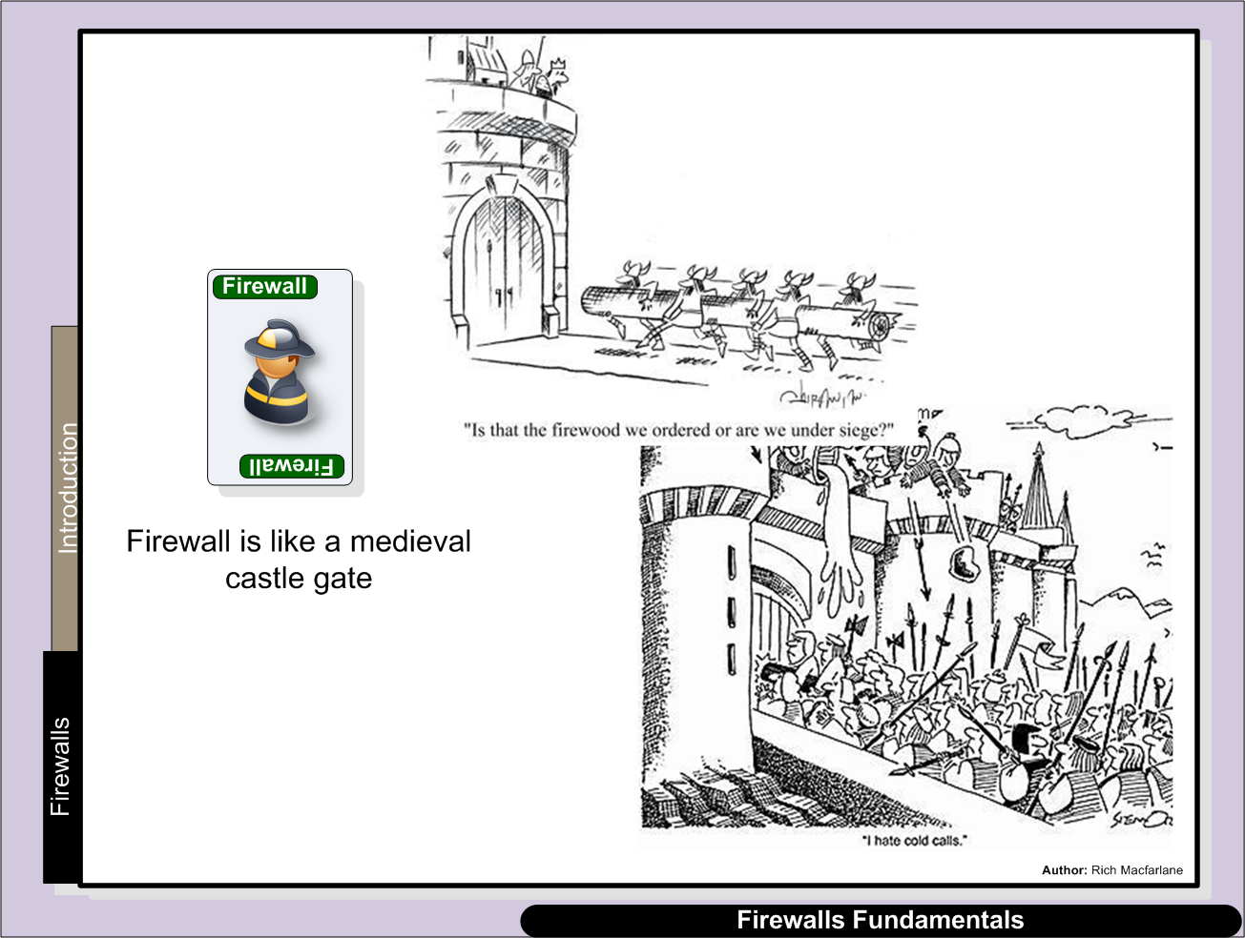
Walls funnel people to the gate
Guard on the gate - decides who passes
through
Choke point – all traffic should pass here

Slide 5
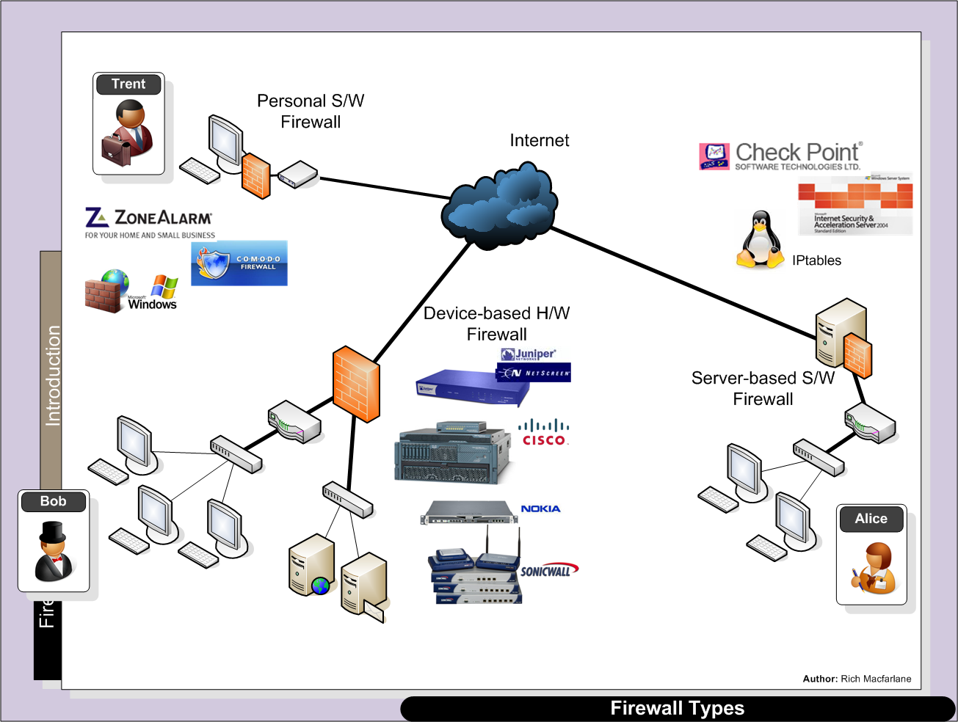
- Firewall built into most OS
Routers with firewalling S/w running
Proxy/Application Firewalls – firewalling specific applications
Hardware firewalling
Custom OS/Hardware

Slide 6
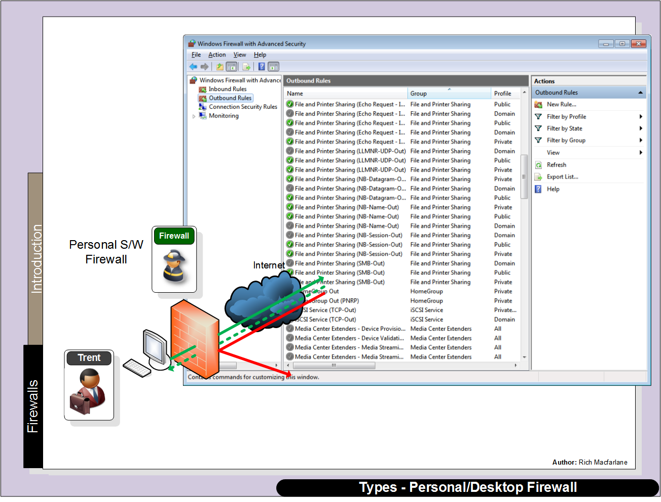

Q. Where is the perimeter f/w(s) implemented?

Slide 7
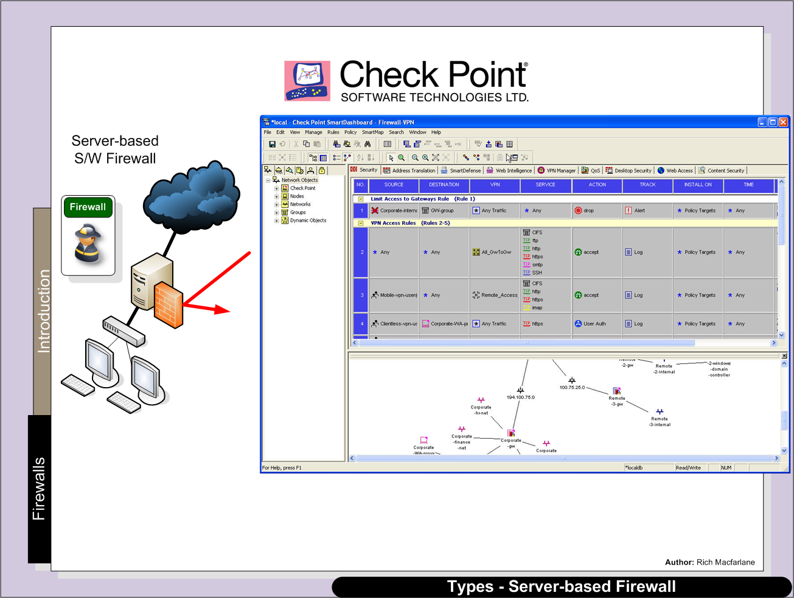

Slide 8
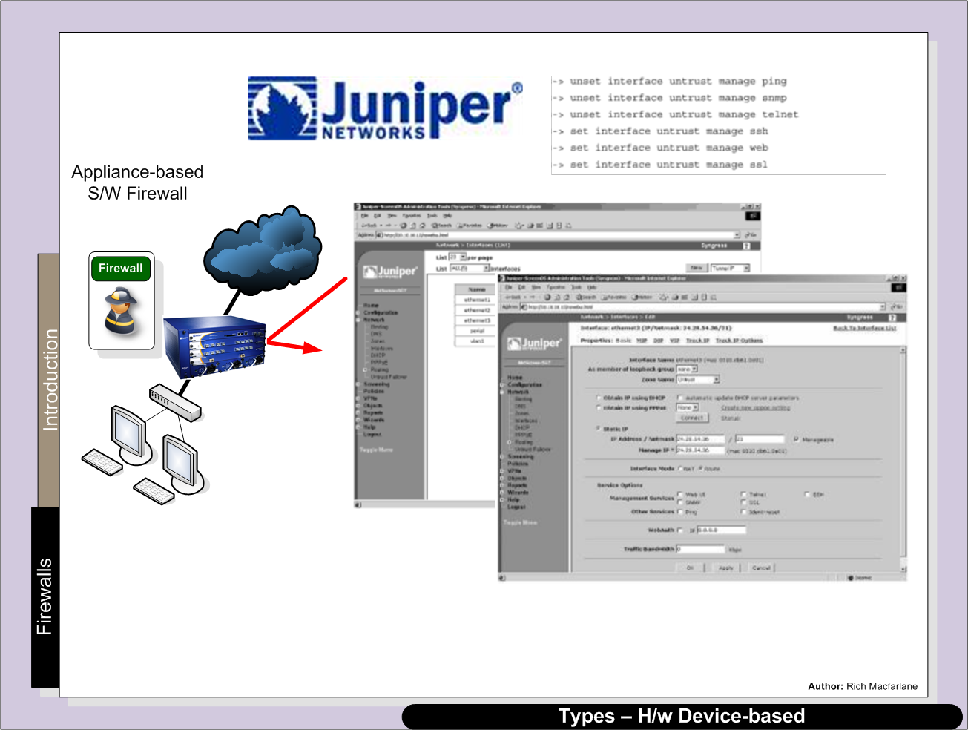

Slide 9
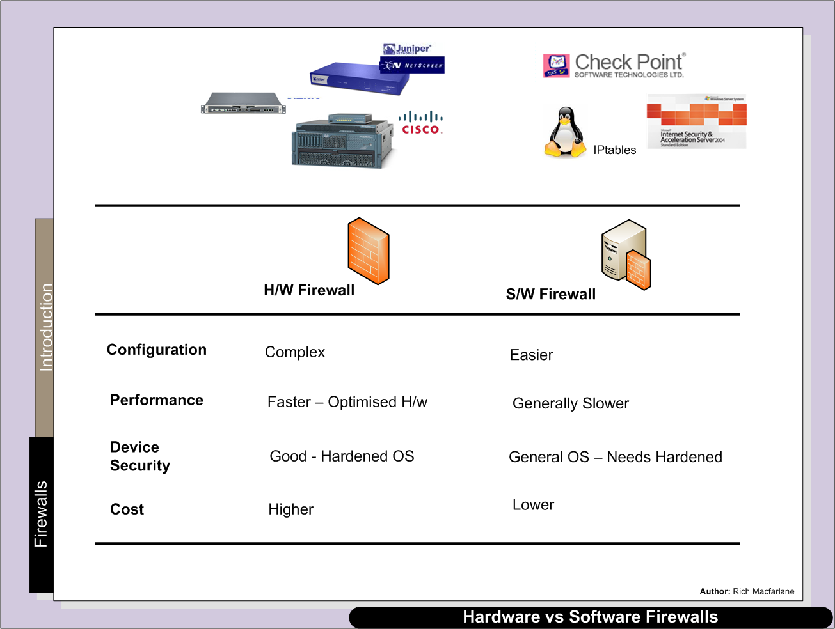

Slide 10
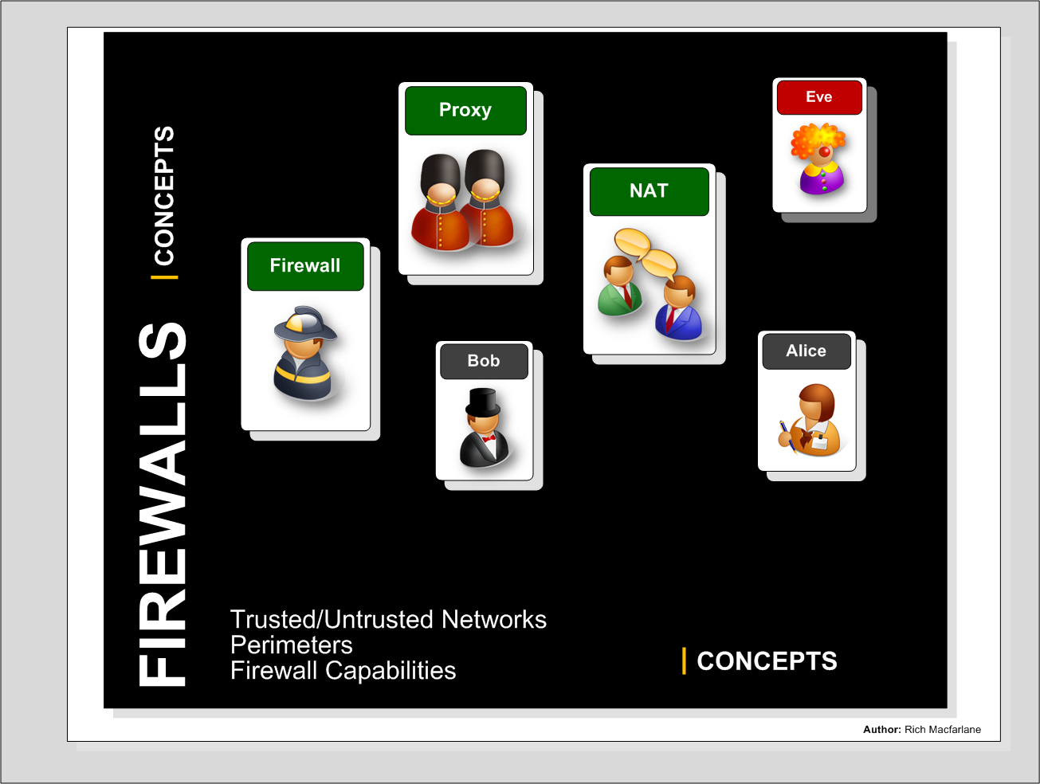

Slide 11
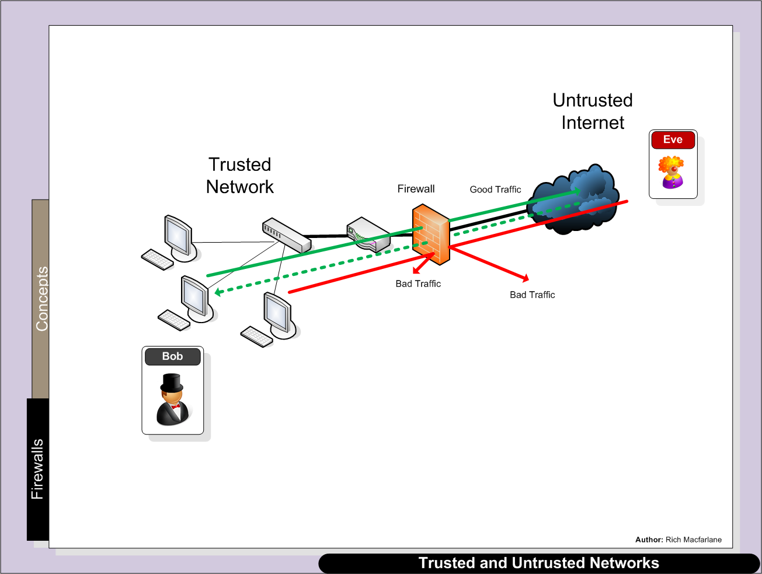
Trusted & Untrusted Network – Perimeter Between
Firewall Deployed at trust boundary
Perimeter between trusted/untrusted networks
Bob inside his trusted network – private network connected to the Internet
Under Bobs organisations control
Eve out on the Internet – the untrusted network

Slide 12
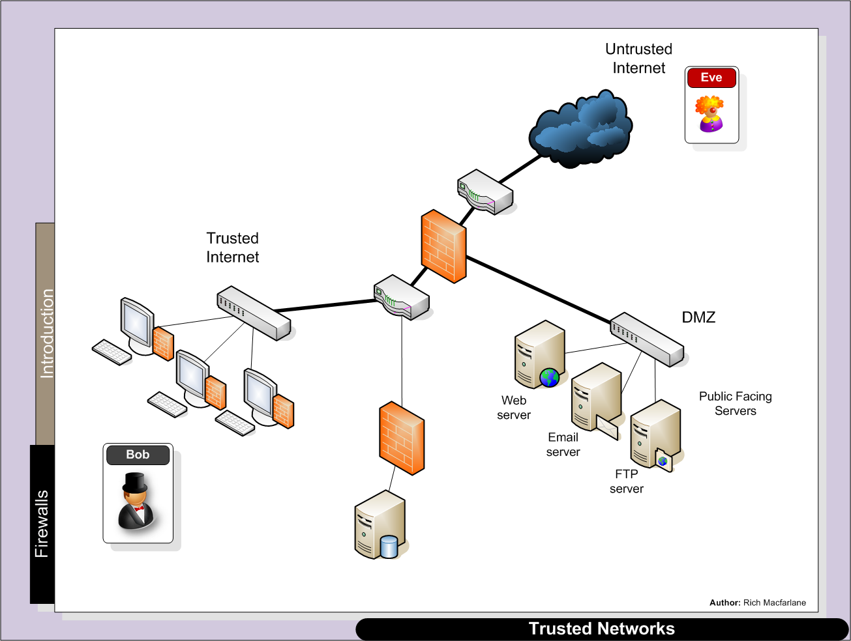
Segmentation of Internal Networks
Using multiple layered firewalls, at the perimeters - between more and less trusted networks
More/Less trusted – risk to assets
Different firewall filtering rules
Internal hosts access to Internet – higher risk

Slide 13
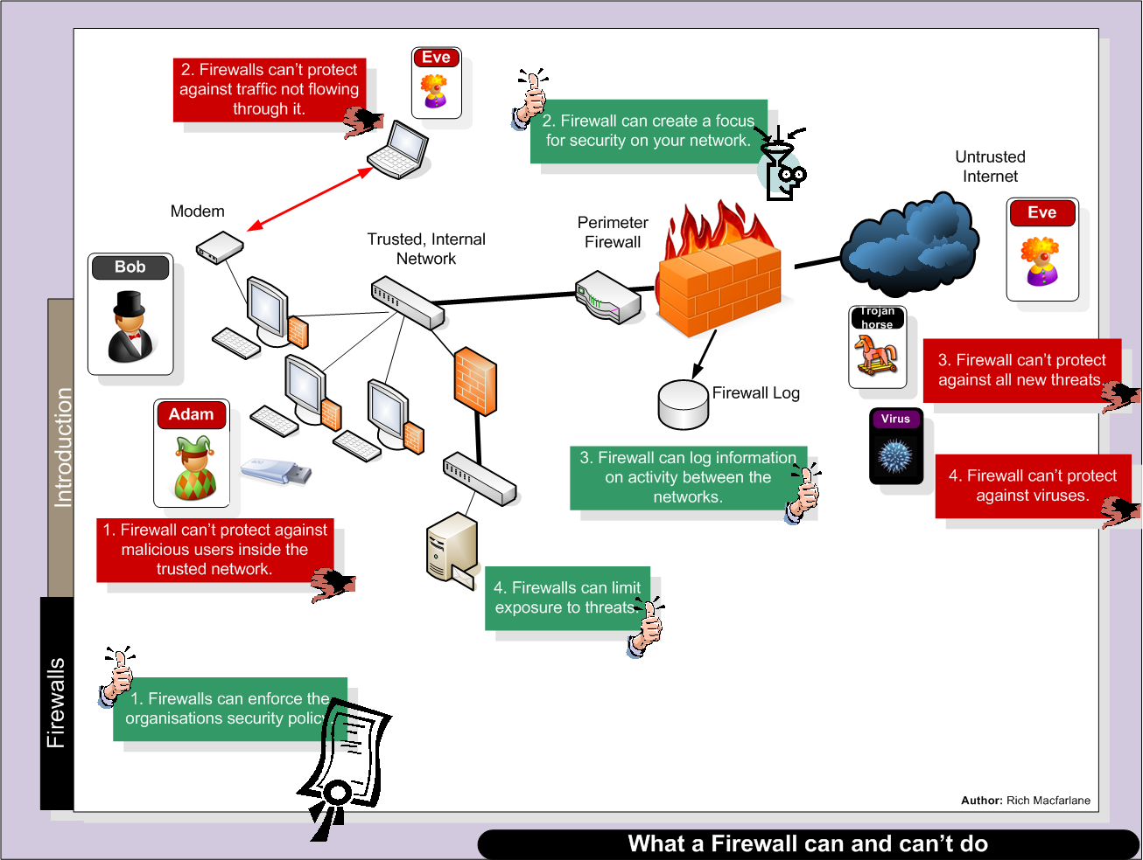
Fox in the Hen house
“Perimeter Firewall – like a crunchy shell round a soft chewy centre”
-- Bill Cheswick

Slide 14



Slide 15
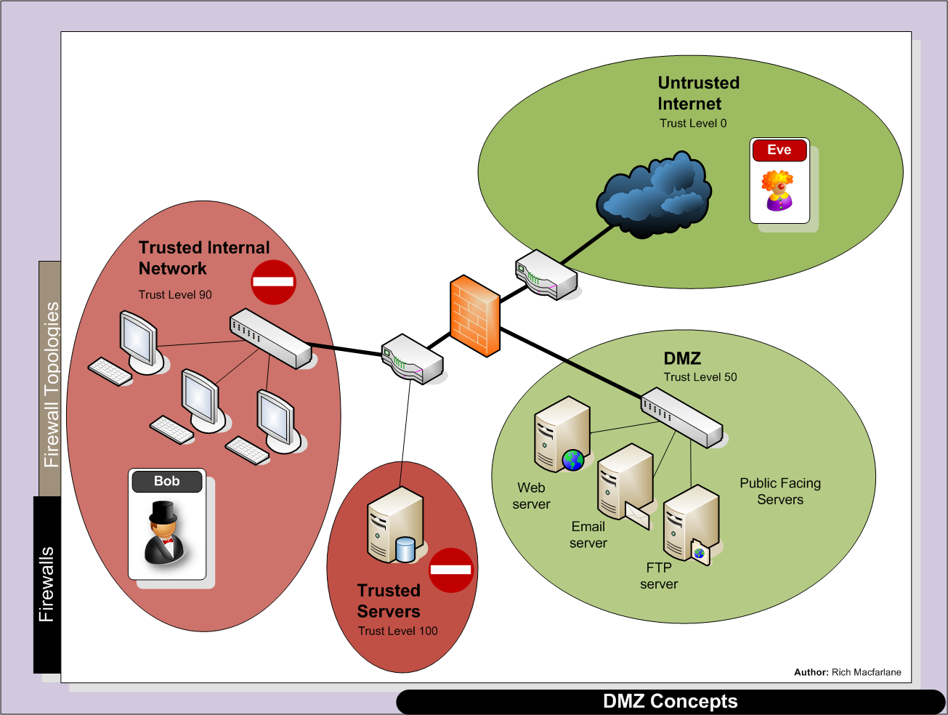
Network/Zone Trust Levels
Firewalls can be deployed within various Topologies
Based on Idea that Networks to be segregated - have different
Trust Levels/Risk Levels
Create different Security Zones
Untrusted Internet highest Risk = lowest Trust Level
Internal Network might browse Internet = higher risk
than local server network

Slide 16
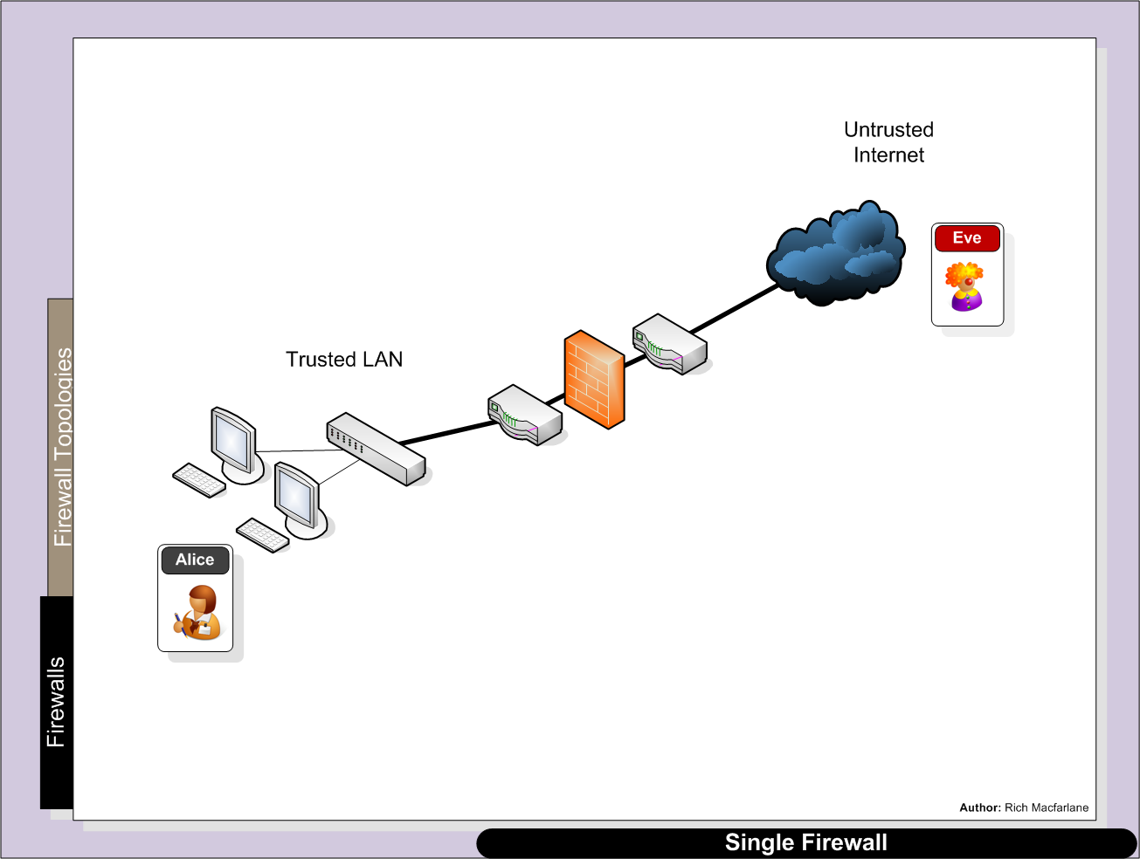
Firewall Deployment Topologies
Single Firewall
Small Organisation/Home User
No Services to provide
Segregating internal networks
2 security zones

Slide 17
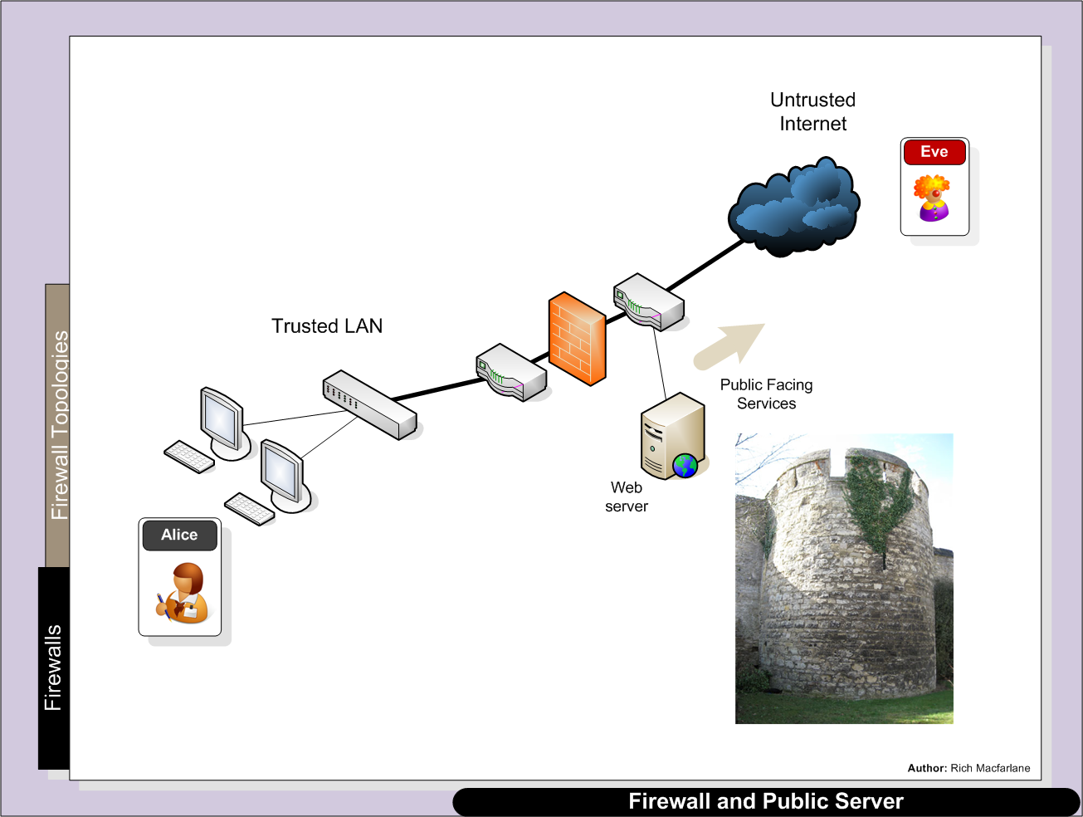
Single Firewall – Web Server
Providing Services to external network
Server Placed outside the trusted network
Bastion Host – Server Hardened
Provide Static Web pages
No trust relationship with internal network

Slide 18
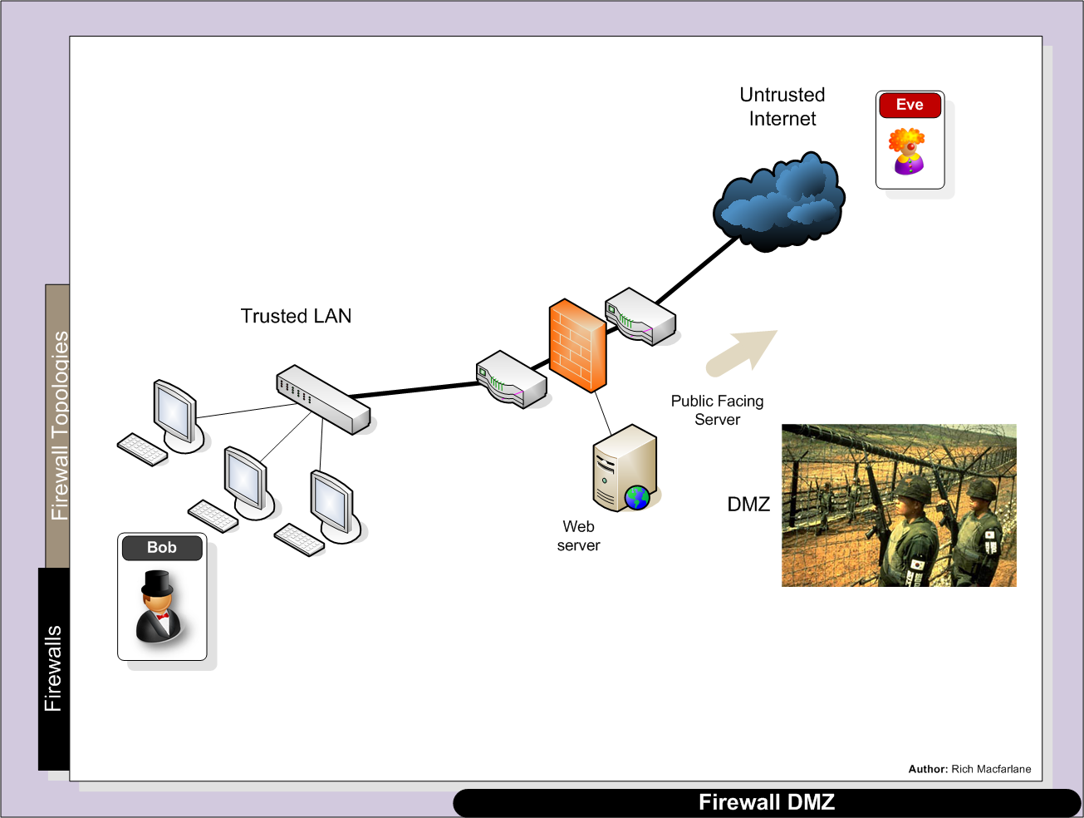
Single Firewall - DMZ
Providing Services to external network
Server Placed on DMZ network
Firewall creates 3 Security Zones
External/DMZ/Internal

Slide 19
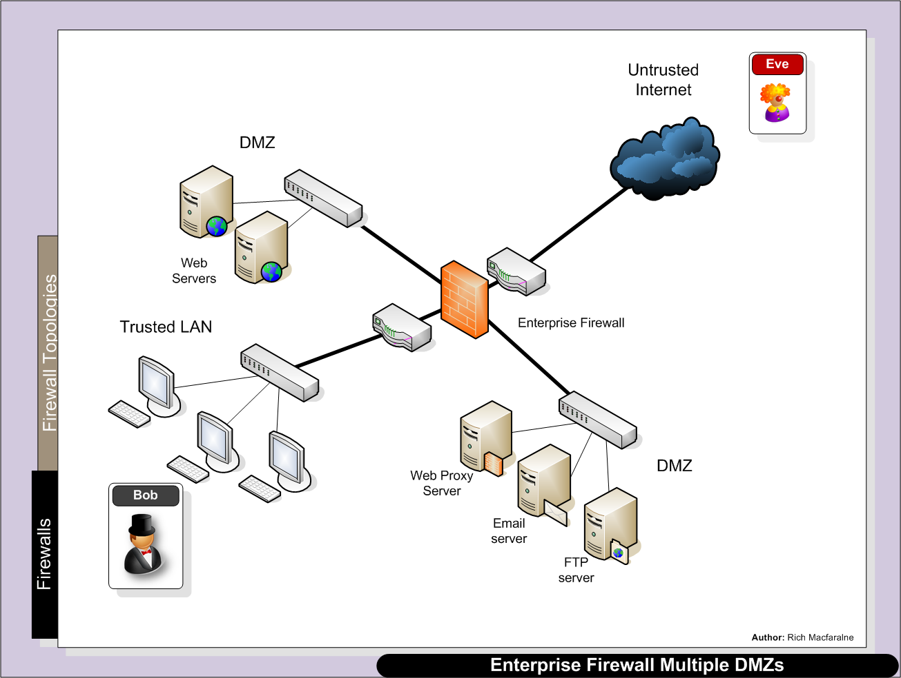
Enterprise Firewall – Multiple DMZs
Different Services provided to external network on different DMZs
Firewall creates different Security Zones for different services

Slide 20
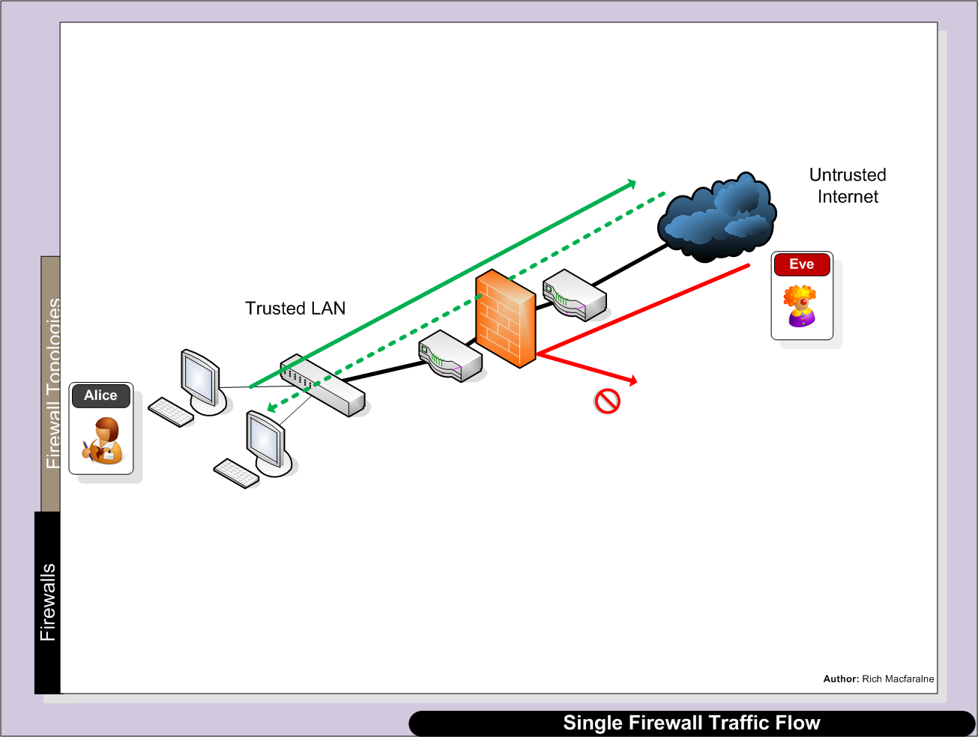
Firewall Traffic Flows
Understand traffic flows through firewalls
Based on security zones/firewall implementations
Typically default is only Higher trust zone to lower allowed to initiate connection
Stateful also allows return traffic
Lower to higher trust zone not allowed to initiate connection – packets dropped
Windows Firewall – lab problems – Ping from GNS3 Router to local host
Allows ICMP out + return traffic
Drops ICMP by default incoming

Slide 21
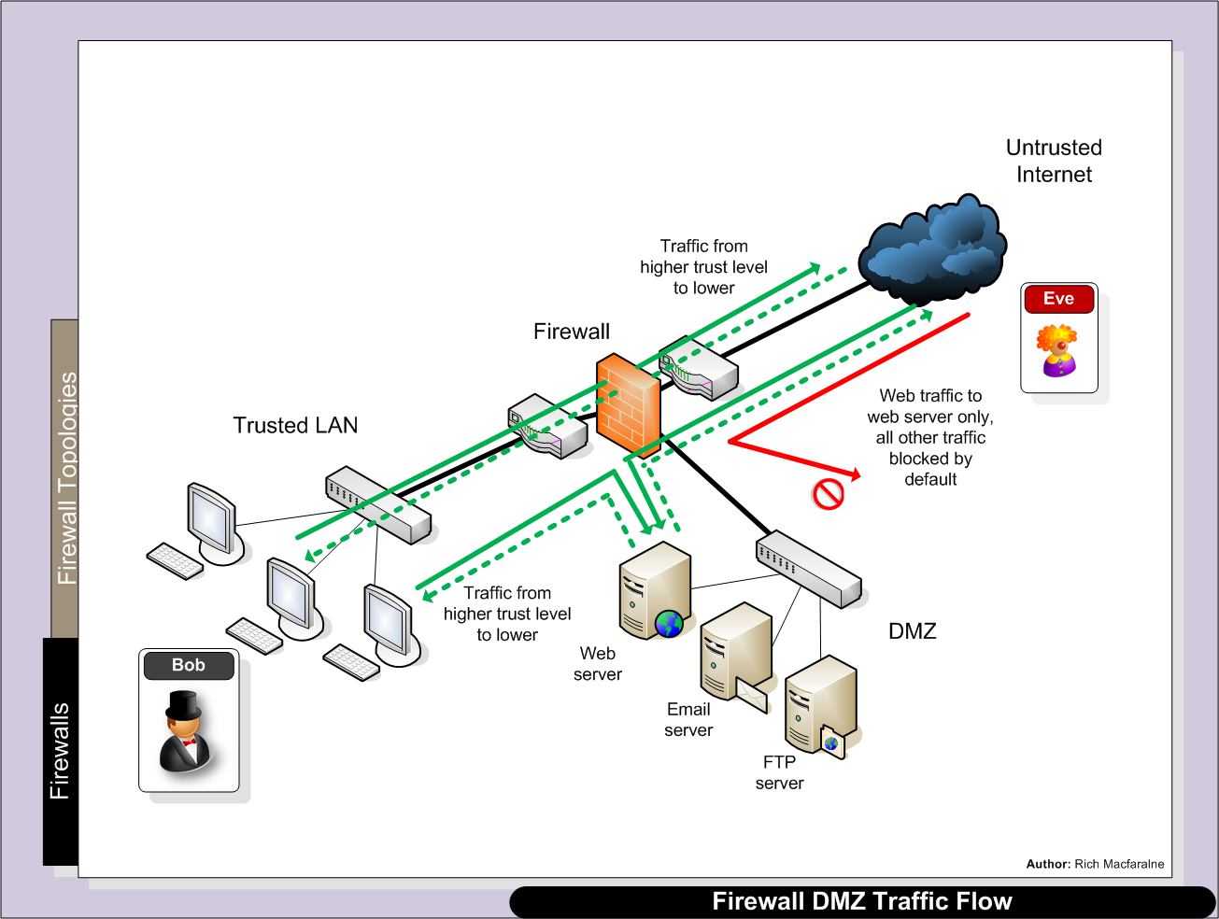
Default Rules the same:
Higher trust zone to lower allowed to initiate connection + allows return traffic
Lower to higher trust zone not allowed to initiate connection
Firewall Rules Out -> DMZ have been added to allow
access to web server

Slide 22
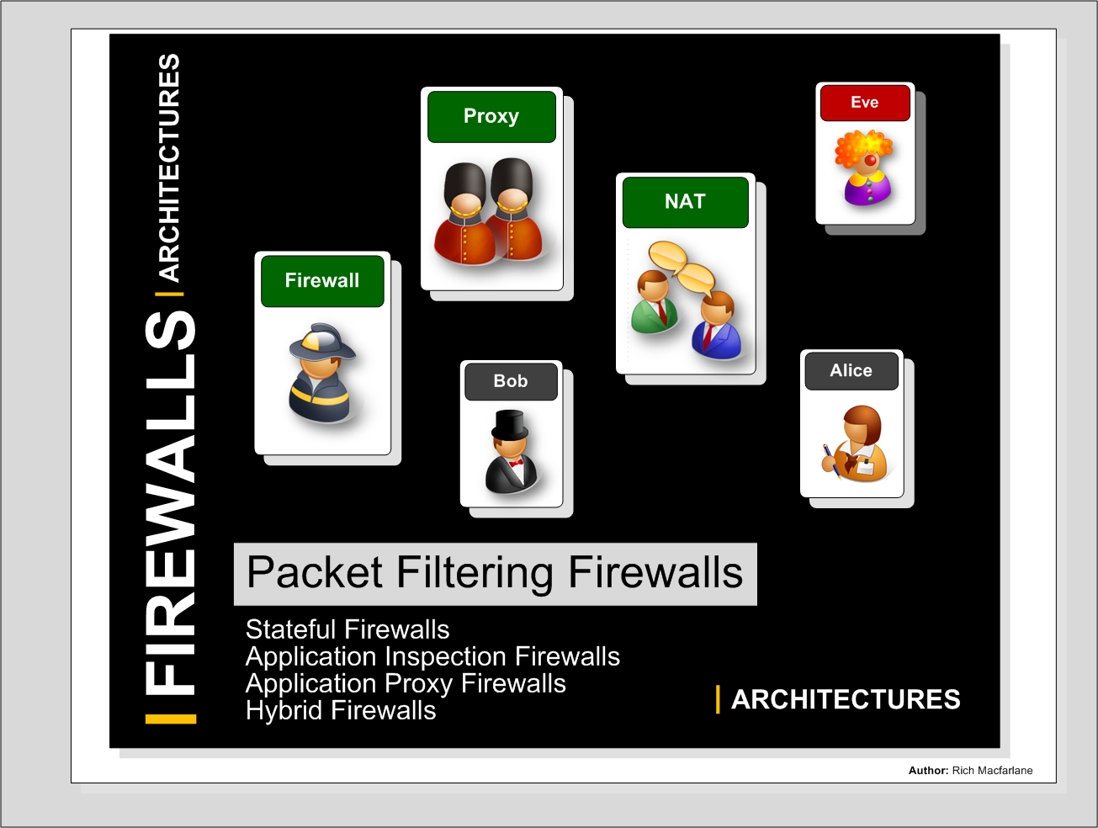

Slide 23
Packet Filtering
Stateless Packet Filtering
Oldest/most basic filtering firewalls
Easily deployed on existing routers – Cisco in lab
Cheap
Very fast
Only examine lower network layer headers IP/TCP
Can handle simplest filtering efficiently
Each packet examined/filtered individually
No concept of connection state
Easy to bypass by attackers
Attacker can spoof connected state by crafting packet
Data Content of Packet not examined
Can be used in front of more advanced firewalls
Overview
Threats

Slide 24
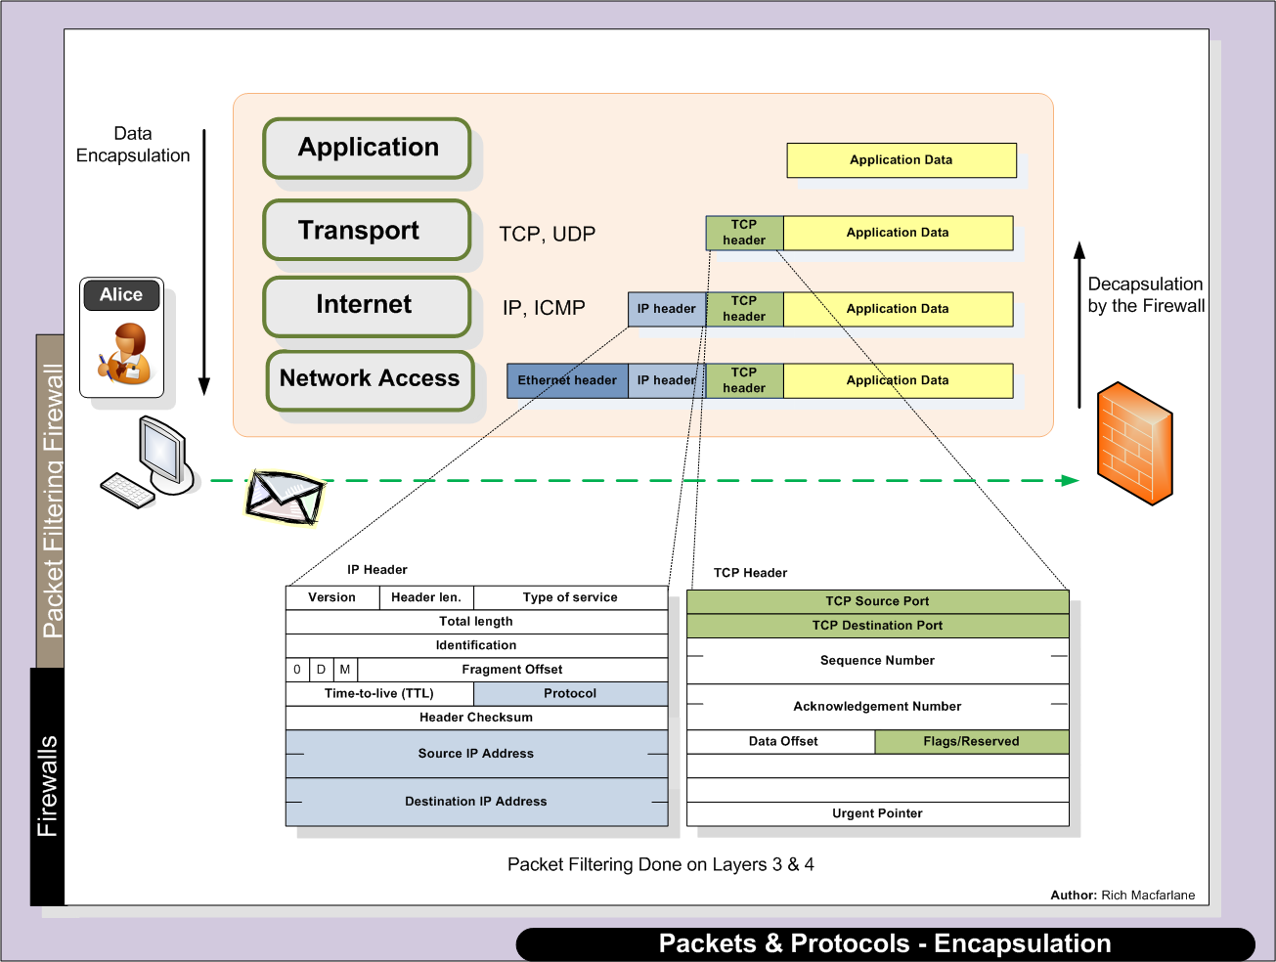
Firewalls are routers - de-capsulate packets + compare IP/TCP header values to rules
Q. What could IP Addresses be used to filter?

Slide 25
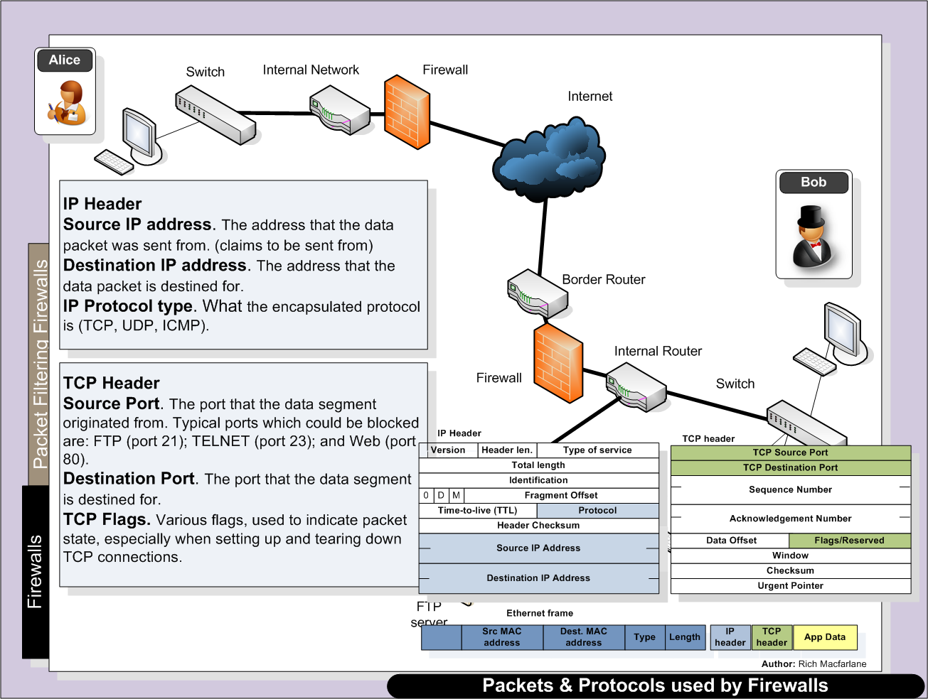
Q. What can we use Protocols/Ports to filter?

Slide 26
Packet Filtering Process
Stateless Packet Filtering
Firewall de-capsulates each packet
Reads fields of IP/TCP packet header field values
Src/Dest IP Address
Src/Dest TCP/UDP Port
Compare values against filtering rules in the firewall
Each rule checked against packet values
If values match rule – rule determines what to do with packet
Packet passed through firewall or dropped depending on rule action
Each packet is filtered individually
No idea of Conversation – or TCP Session
Overview
Threats

Slide 27
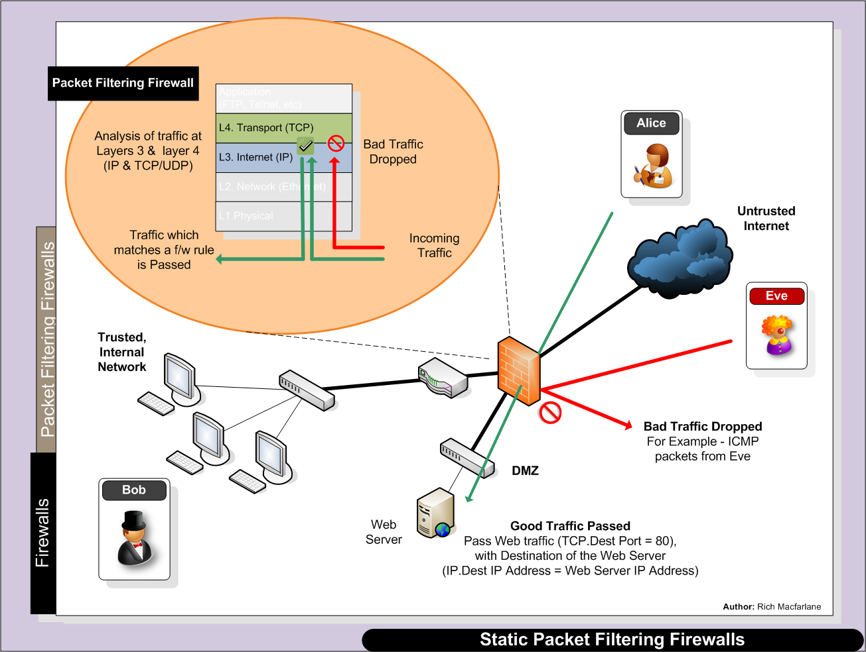
Packet Filtering Process
Alice’s Web browser sends web traffic (port 80)
addressed to the Web servers IP Address

Slide 28
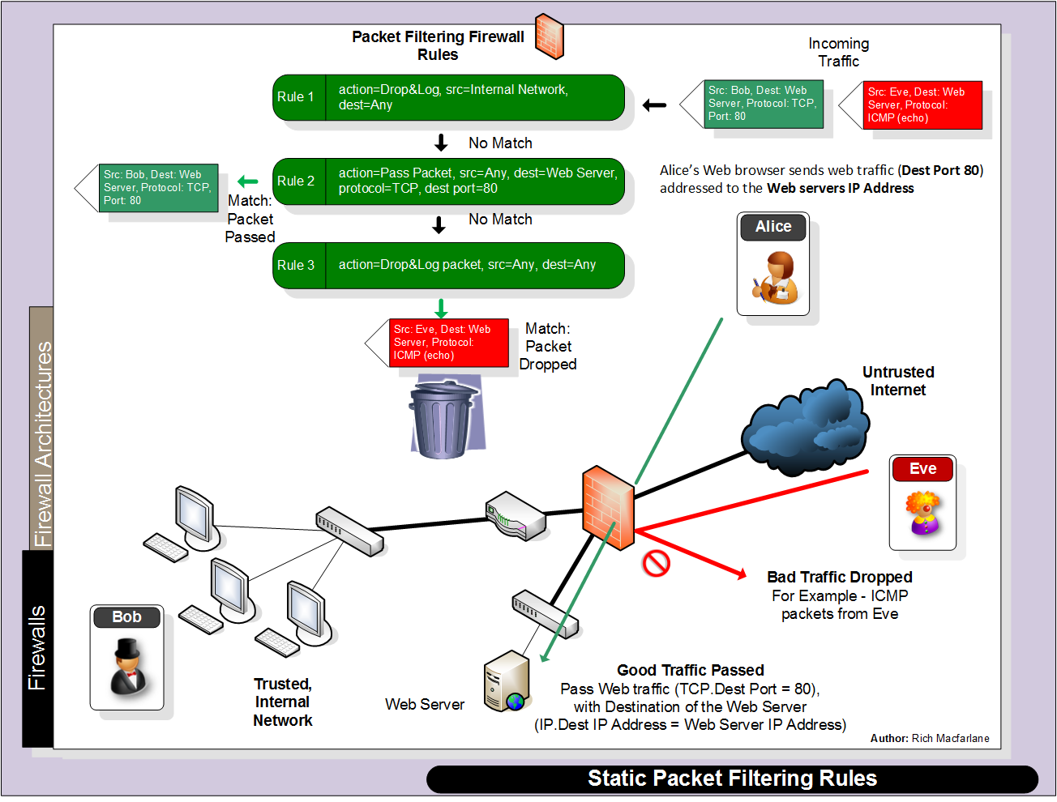
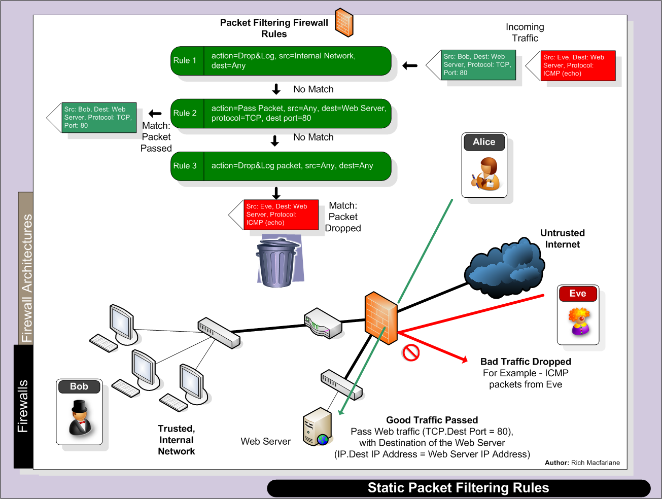
Open or closed firewall?

Slide 29
Packet Filtering Problems
Each packet is filtered individually
No concept of ‘state’ or context of connection packet is part of
Most traffic uses TCP Session/Conversation
Have to open large range of ports for return traffic
Can use TCP Flags – Check if ACK flag for established connection
Easily Spoofed nmap -sA –p1-65000 IP_Address[range]
Does not look into Payload
Application layer attacks
Cannot deal with complex protocols
FTP uses fixed port number for command session
FTP uses dynamic port numbers for data sessions
Negotiated and passed in data payload of packet
Would have to open up large range of ports – security hole
Overview
Threats

Slide 30
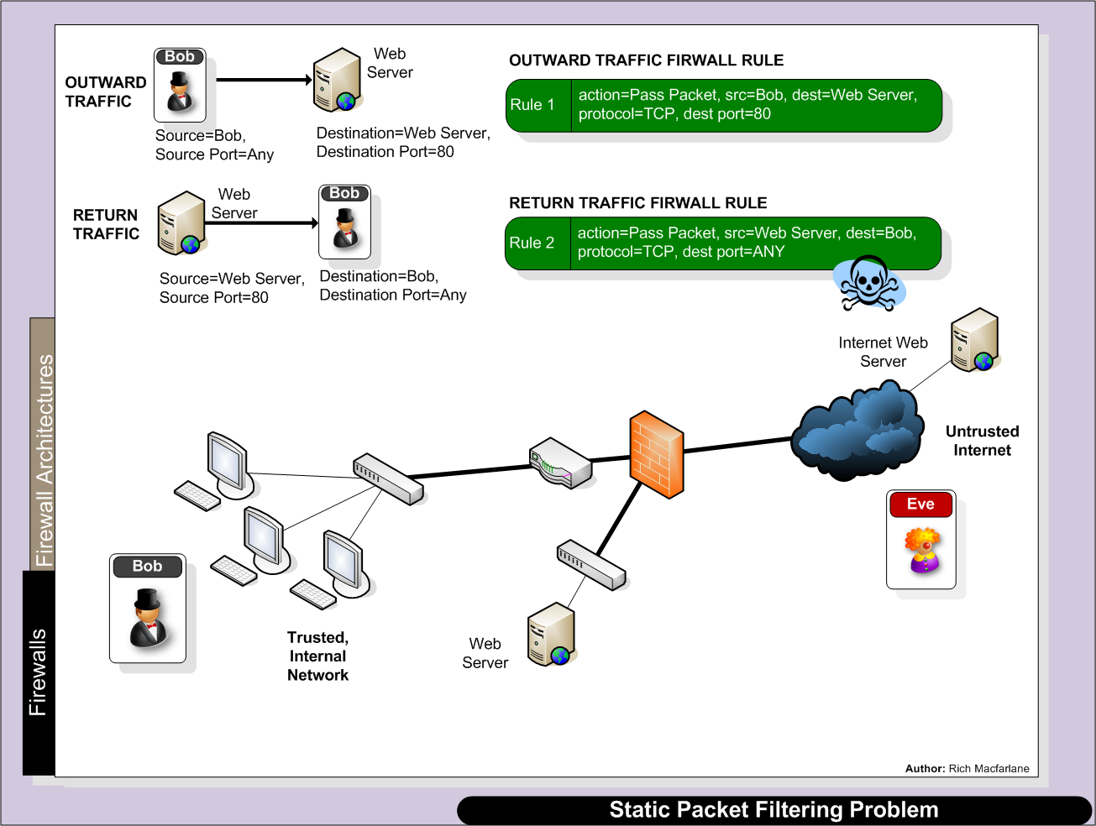
Policy allows Bob to browse the web
Firewall Rule to allow traffic out ok
Return rule - Only server port known in advance

Slide 31
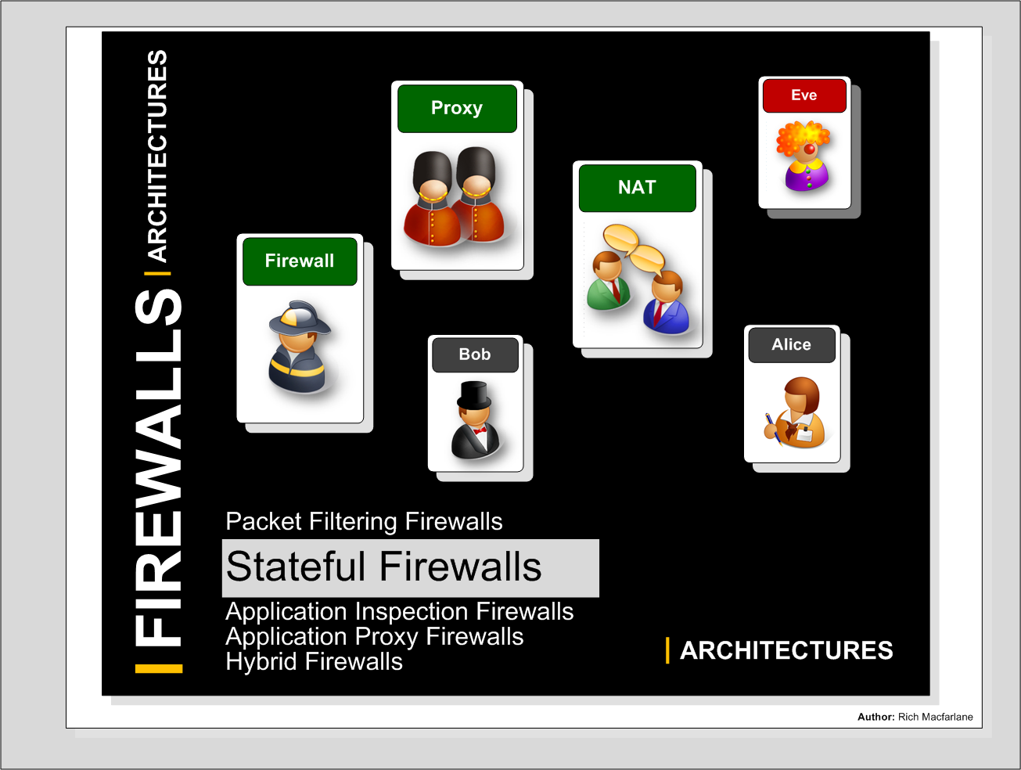

Slide 32
Stateful Firewalls
Stateful Packet Filtering
Packet Filtering firewall using rules same as stateless, but additionally track connection state
Checks packet in context of connection
State of traffic flows tracked
Maintains cache about current connections
State Table used to record initiated connections (once they have been passed by firewall rules)
State Table checked for return traffic matching stored connection
Match allowed through
No match – check packet against firewall rules
Application Data Content of Packet still not examined
Stateful
Firewalls

Slide 33
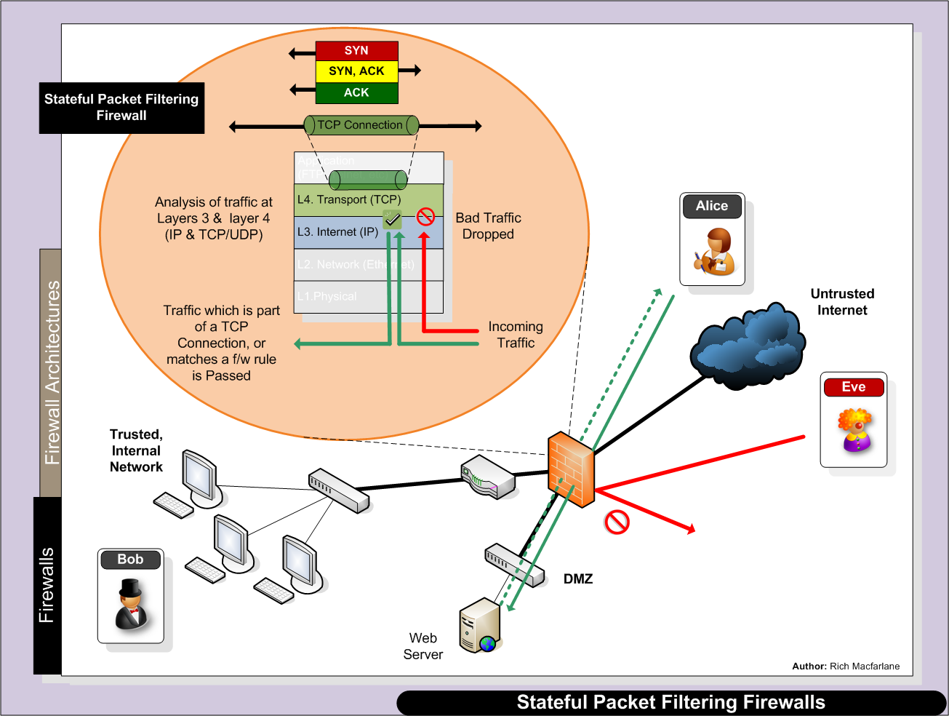
Alice’s return data traffic automatically allowed through firewall, without specific return rule

Slide 34
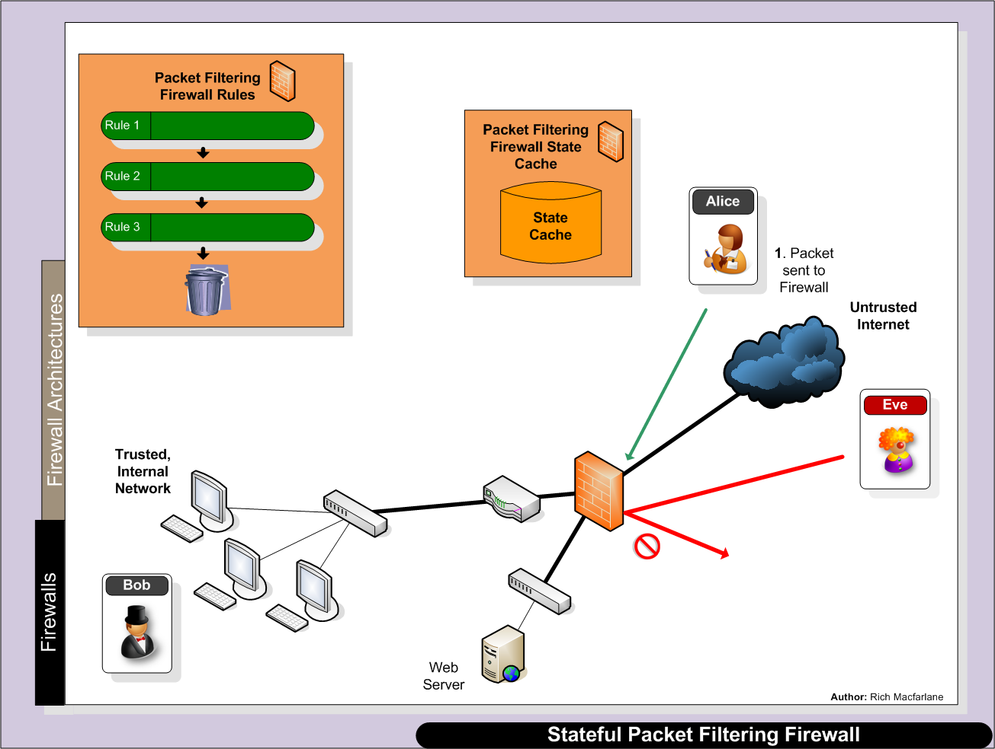
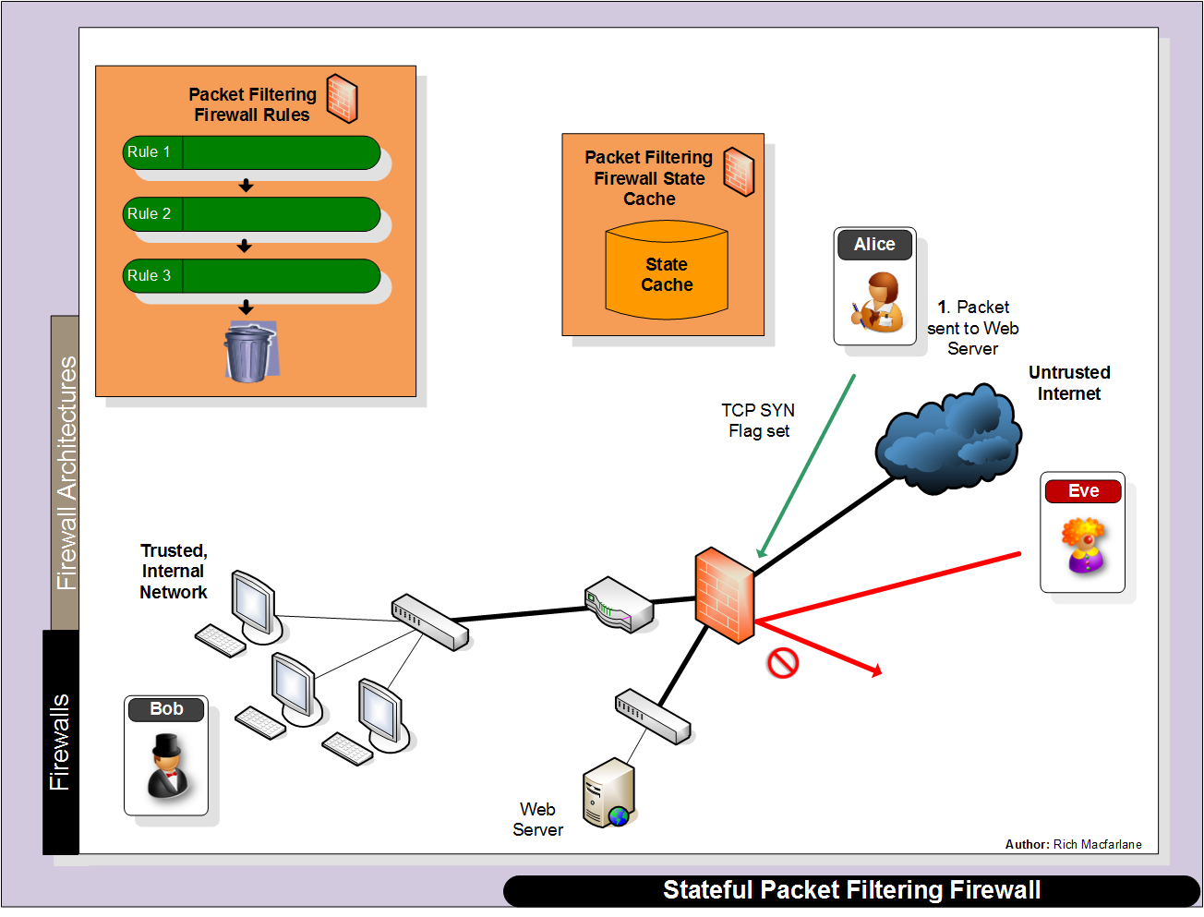
Stateful Filtering Process
SrcIP=AlicePC, DestIP=WebServer,
SrcPort=1777, DestPort=80
TCP flags checked to check if part of a current connection
Alice’s packet has SYN flag set so NEW Connection

Slide 35
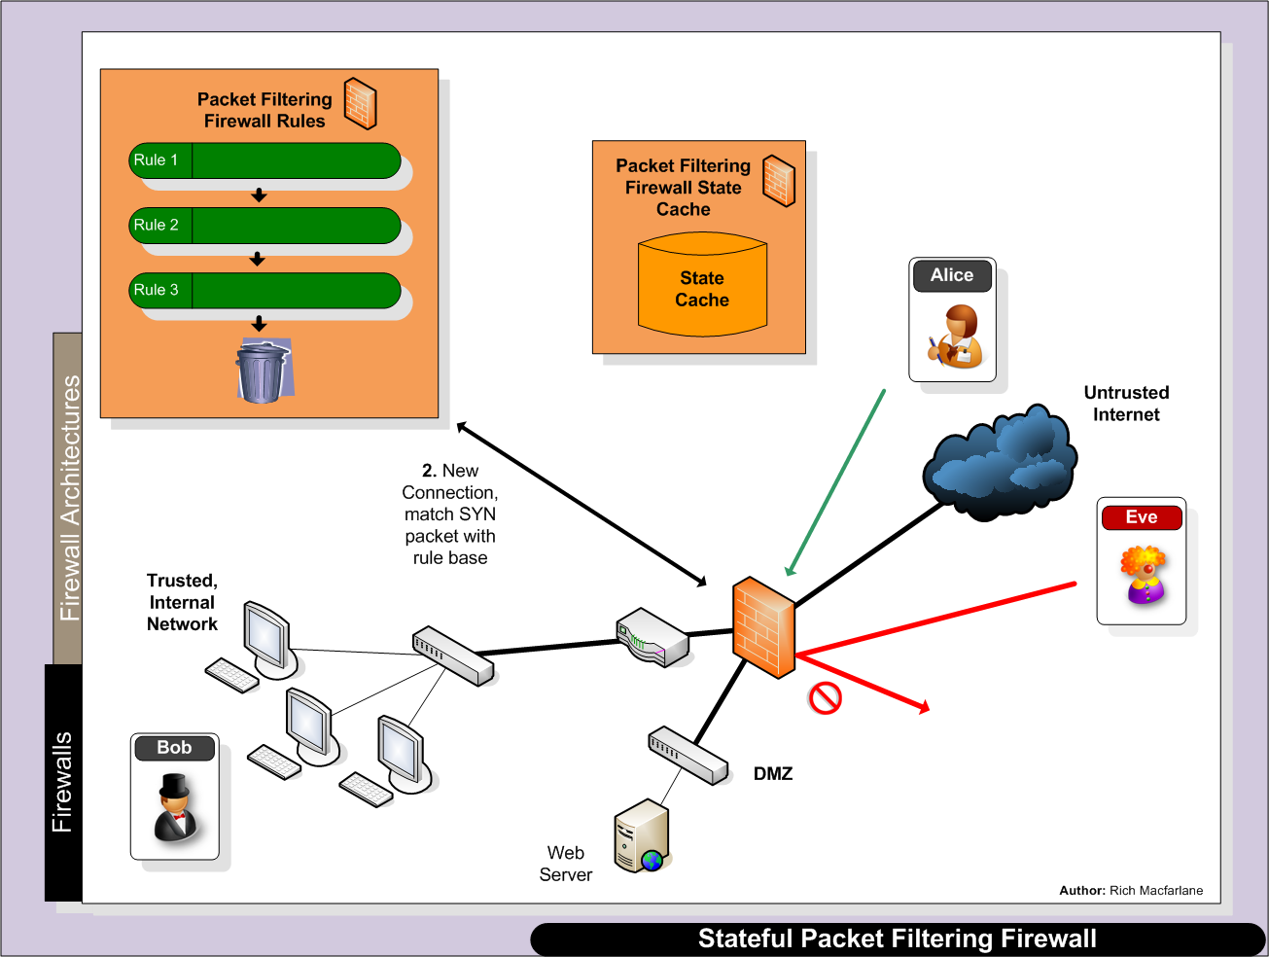
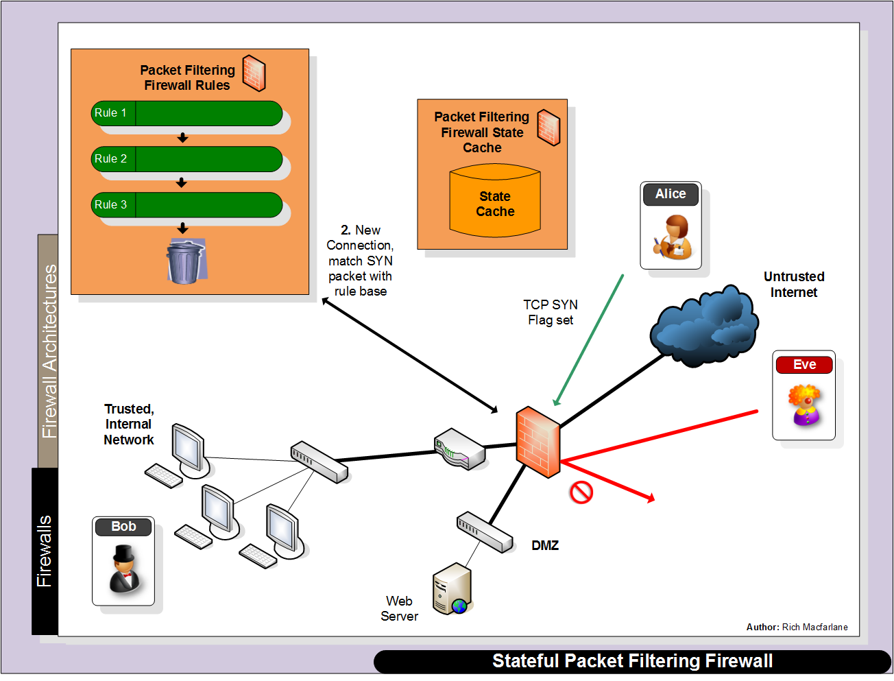
Match against firewall ruleset:
SrcIP=AlicePC, DestIP=WebServer,
SrcPort=1777, DestPort=80

Slide 36
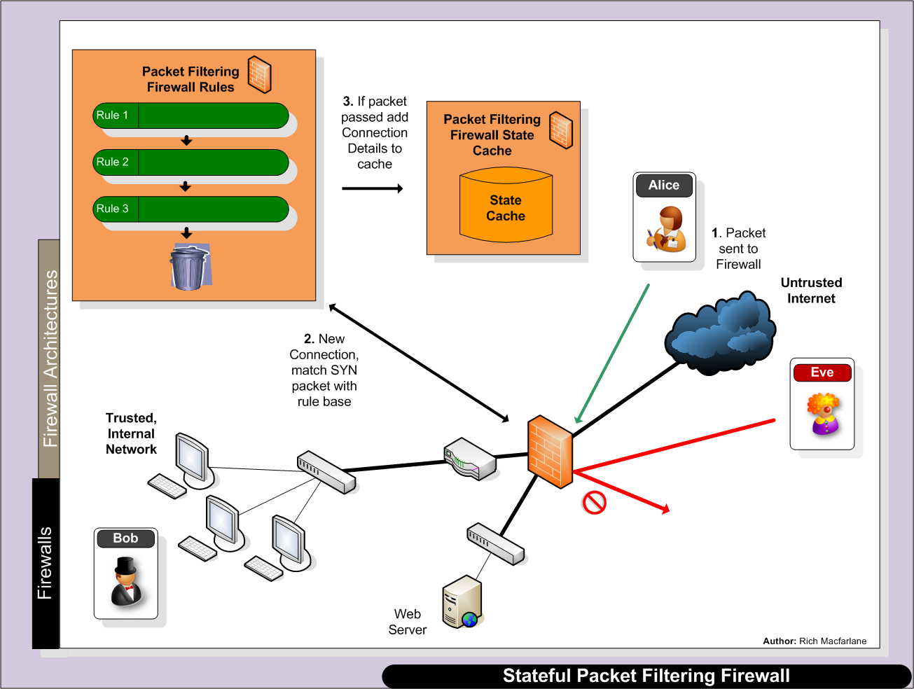
Connection: SrcIP=AlicePC, DestIP=WebServer,
SrcPort=1777, DestPort=80, + State, SeqNos?

Slide 37
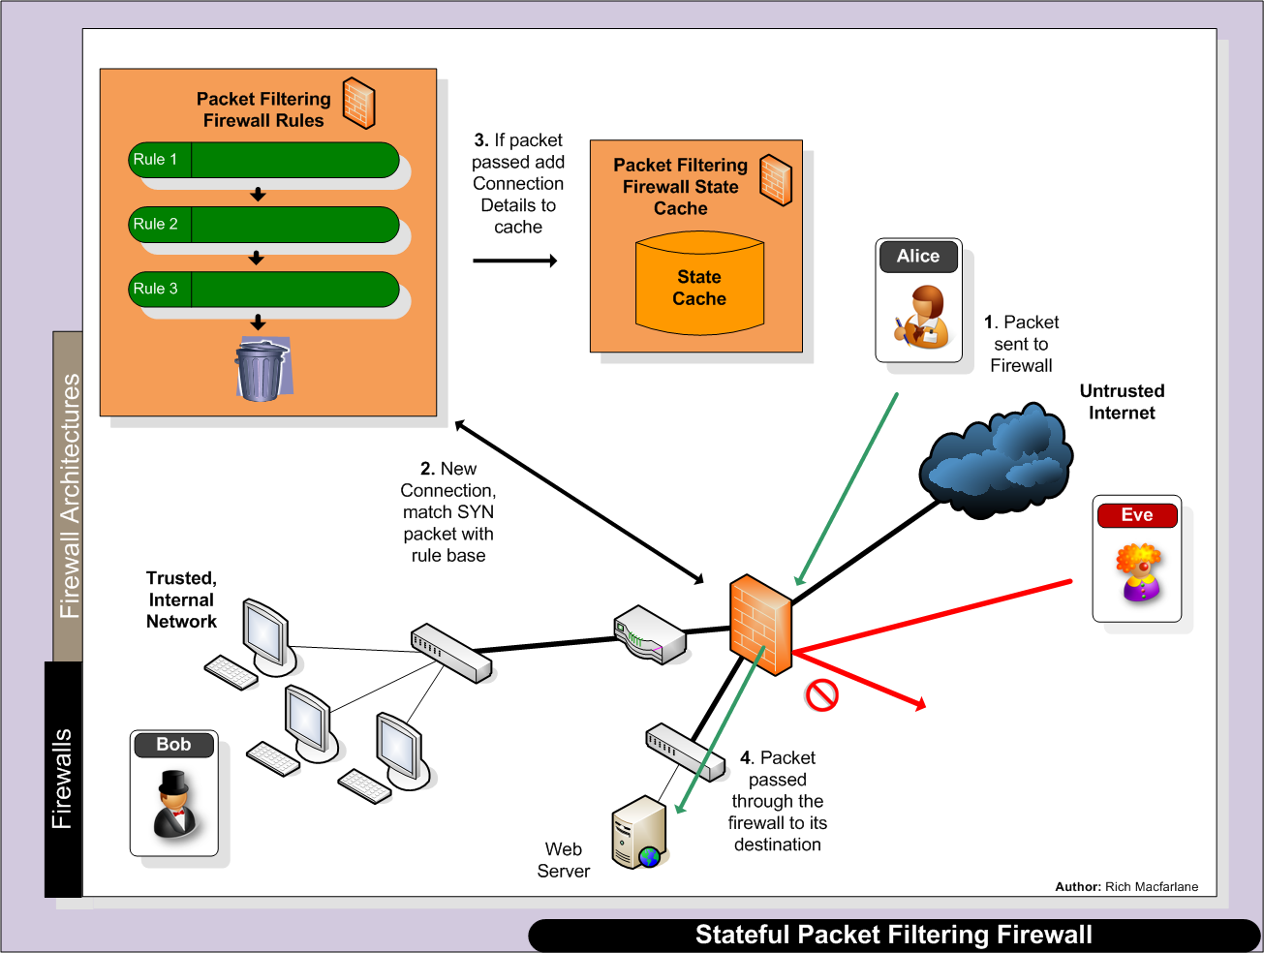
Connection: SrcIP=AlicePC, DestIP=WebServer,
SrcPort=1777, DestPort=80, + State, SeqNos?

Slide 38
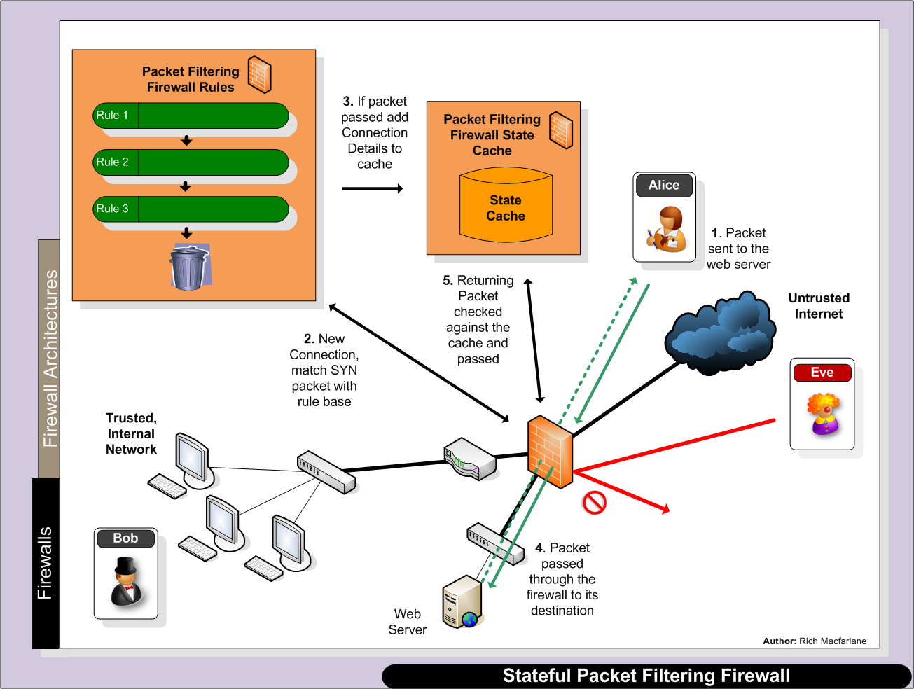
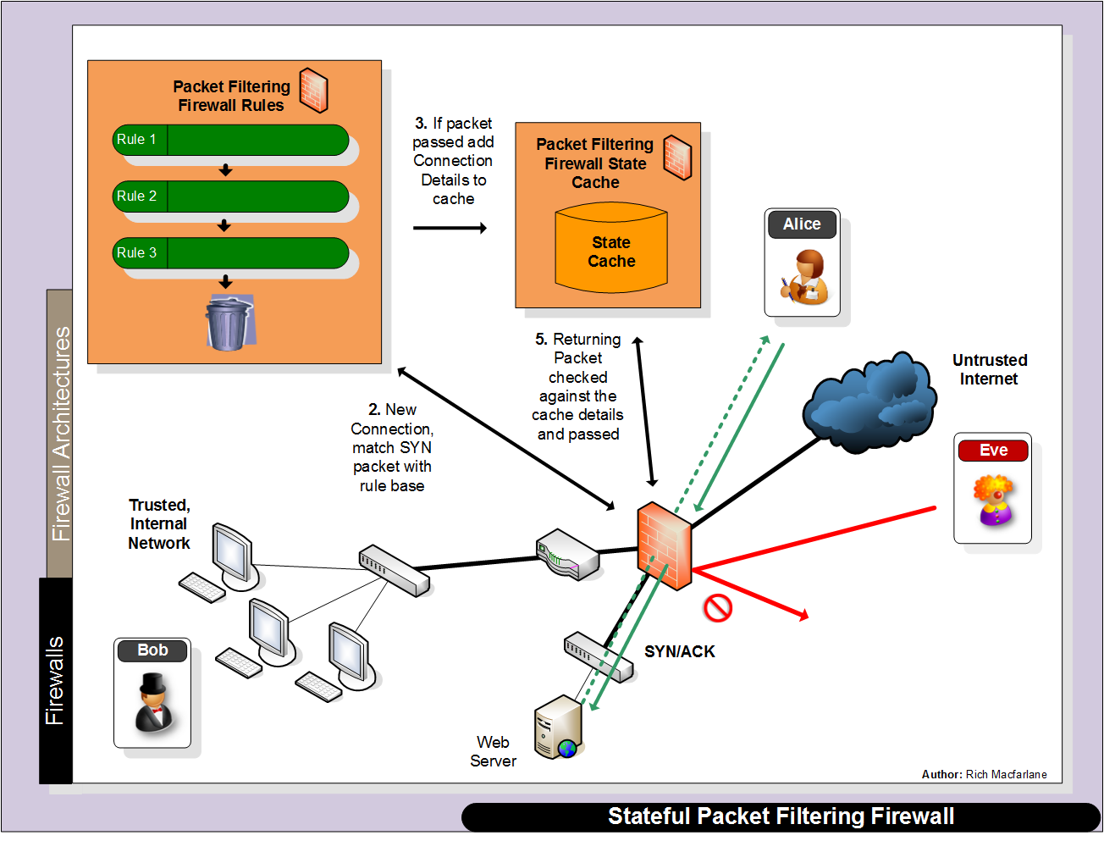
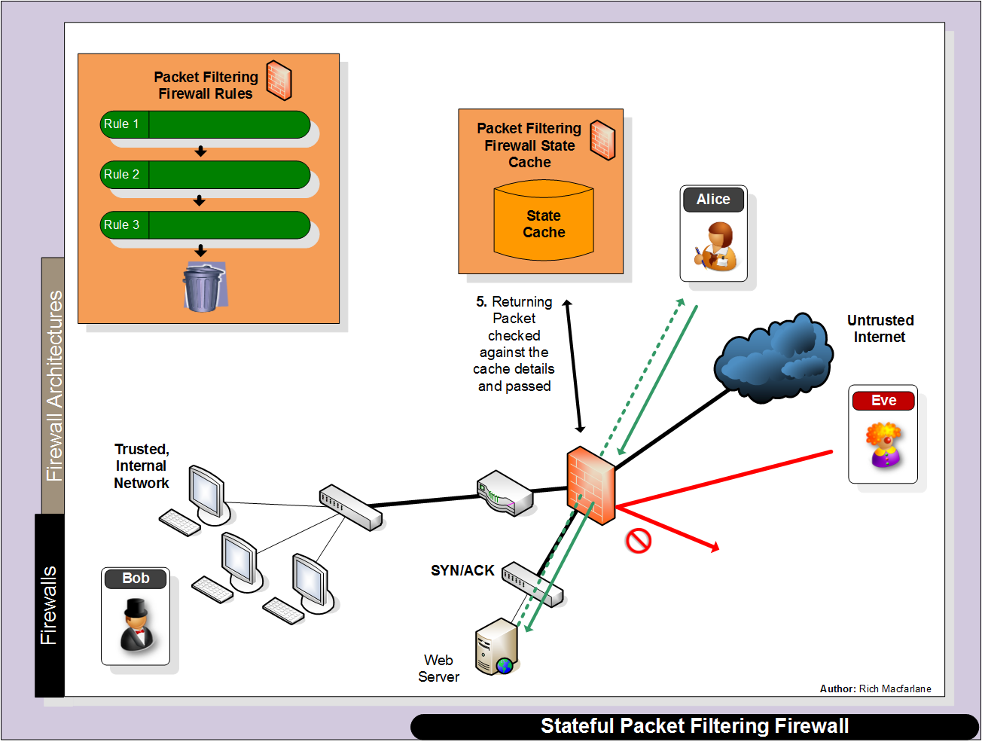
Connection: SrcIP=AlicePC, DestIP=WebServer,
SrcPort=1777, DestPort=80, + State, SeqNos?
Firewall Ruleset not consulted!
SrcIP=WebServer, DestIP=AlicePC,
SrcPort=80, DestPort=1777

Slide 39
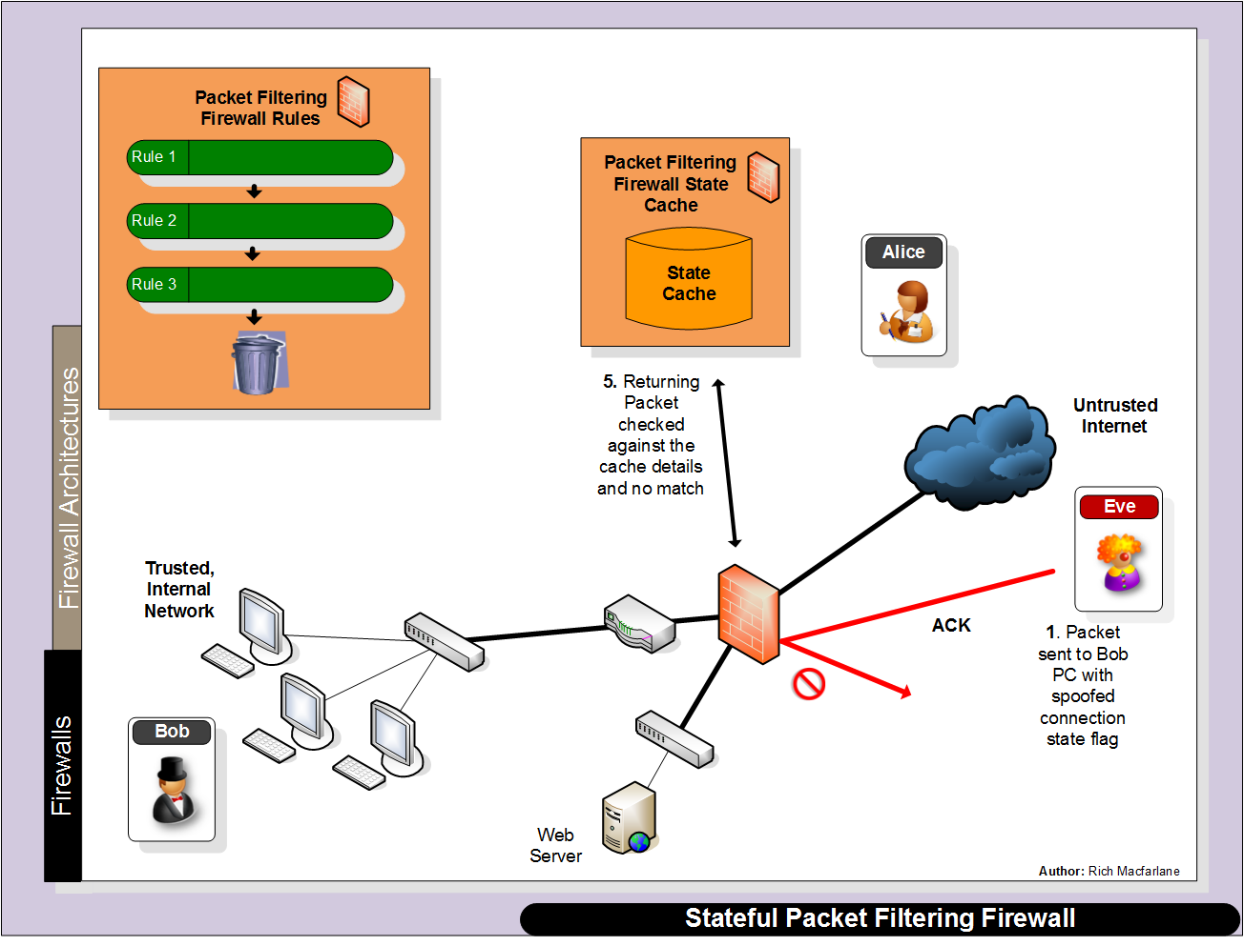
Crafted ACK Packet
Alice# nmap -sA –p1-65000 Bob_IPAddress
Match against firewall ruleset and is dropped
SrcIP=EvePC, DestIP=BobPC,
SrcPort=80, DestPort=666
SrcIP=EvePC, DestIP=BobPC,
SrcPort=80, DestPort=666

Slide 40
Stateful Firewalls
Removing Connections from Cache
Standard connection teardown handshake
RST packet received
FIN/ACK packets exchanged correctly
Timeouts
Typically configurable
Balancing act between availability and removing valid sessions
Seconds to days depending on Vendor/Firewall
Various Timeouts: Connection setup timer/Idle connection timer
UDP
Connectionless – no state flags like TCP
Firewall may use its own state flags – created/replied
Timeout removes connection
Stateful
Firewalls

Slide 41
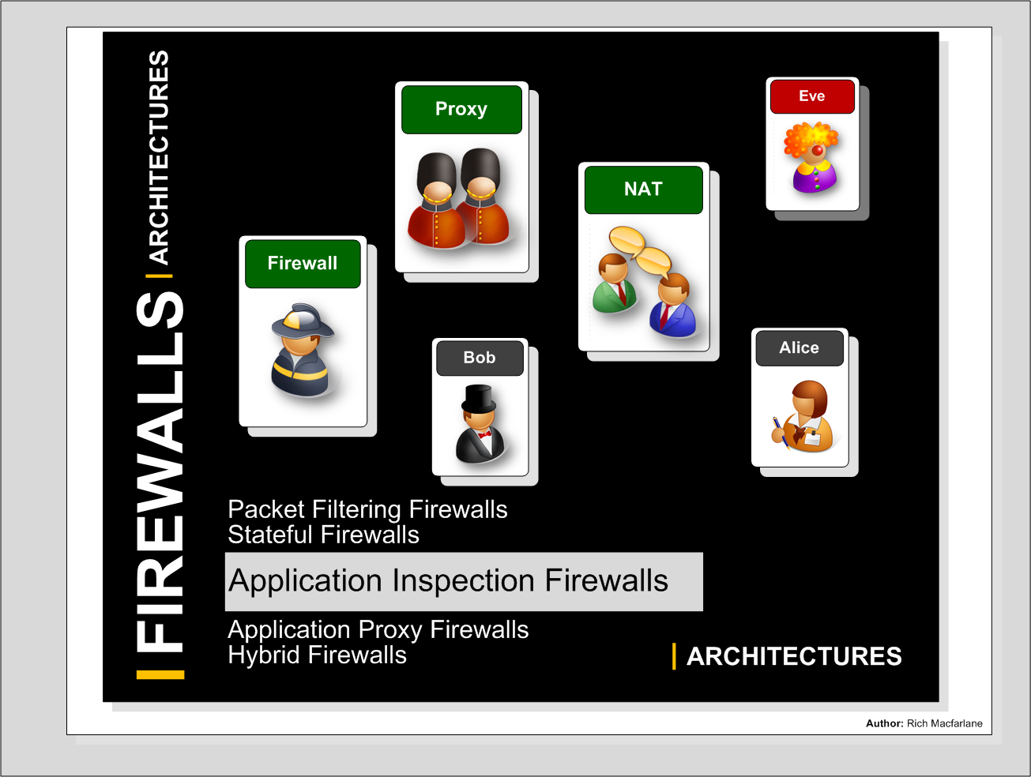

Slide 42
Application Inspection Firewalls
Application Inspection
Typically Stateful Packet Filtering firewall, but additionally inspects the application payload
Can analyse problematic protocols
Multi channel connections
Can Validate Application protocol
Check commands
Can Validate Application layer content
Match attacks in payload
AI
Firewalls

Slide 43
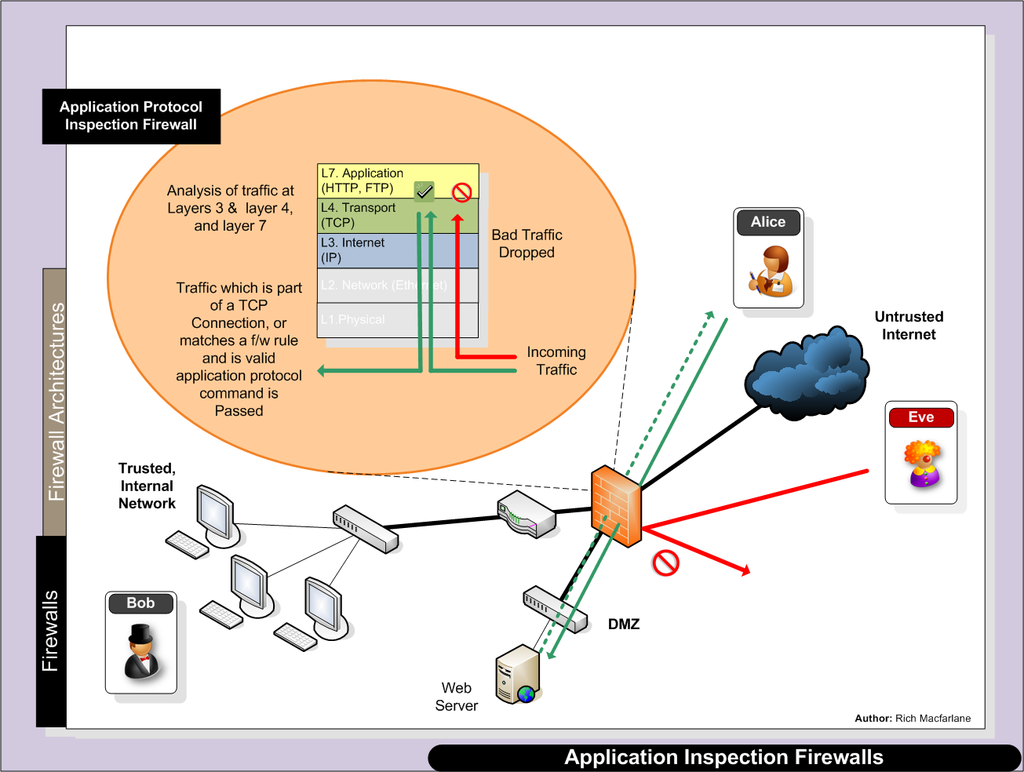

Slide 44
Application Inspection Firewalls
Application Inspection
Deal with complex protocols
FTP, VoIP protocols
Multi channel protocol support
FTP outgoing control session packet payload contains negotiated data channel port number (PORT command)
Inspection Firewall can read this and allow traffic from the server to the data channel port number on the client system
ICMP
ICMP error packets returned from intermediate network devices, or which do not match outgoing packet
ICMP Time exceeded/host unreachable packets
AI
Firewalls

Slide 45
Application Inspection Firewalls
Application Inspection
Can validate protocol content/commands
Check for valid commands for protocols
SMTP commands only in sessions on TCP/25
Enforce security policy
Certain protocol commands not permitted
Drop SMTP packets with VRFY command
Typically pattern matching payload text
Entire pattern may have to be in single packet
Fragmented packets
Signature based – can be bypassed by altering commands slightly – add a space, or encode characters
AI
Firewalls

Slide 46
Application Inspection Firewalls
Stateful packet filtering + inspection of Application payload
More Secure than Standard Packet Filtering
Validation of application protocols
Some content filtering
Fast
Not as fast as Static Packet Filtering
Faster than a Proxy
Up to Gb range depending on vendor
Can be used as main perimeter connection on large pipe to Internet
Support many protocols
More complex protocols which use payload to communicate
Video/Audio/Multi channel protocols
Stateful
Firewalls

Slide 47
